Slide 1
Create A Mobile Application

Slide 2
About Mobile App Development
Mobile App Development is the creation of applications, or apps, that run on mobile devices like phones and tablets
Two most popular platforms today are iOS and Android.
Quite a few people make a good living developing and selling apps.

Slide 3
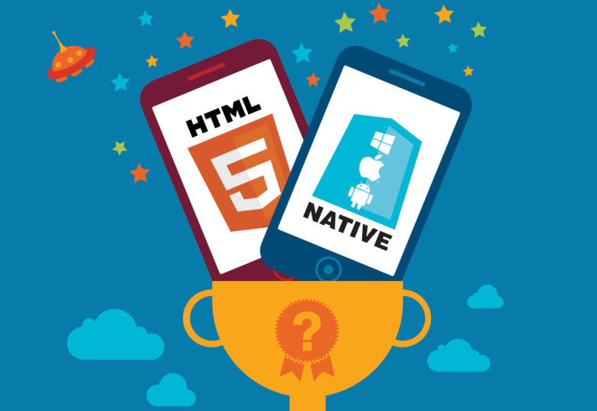
Types of Mobile Apps
Native mobile App: Work on one platform - Android, iOS, BlackBerry, Symbian, or Windows Phone.
Mobile Web App:
Websites that run by a browser and typically written in HTML5.
Hybrid App:
This type of application has cross-platform compatibility but can still access a phone’s hardware. Uses App-embedded browser.

Slide 4
What is PhoneGap?
Web based mobile development framework based on the open source Cordova Project.
Allows you to quickly create App Store ready mobile applications. language.
Watch the Intro Video
(3 min)

Slide 5
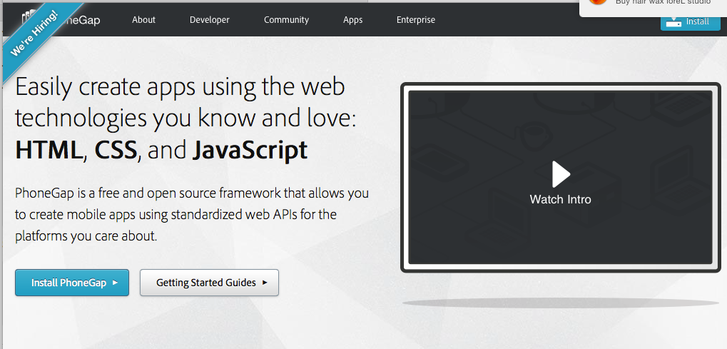
Features of PhoneGap
Allows use of standard web technologies, such as HTML 5, CSS 3, and JavaScript for cross platform development
Avoiding each mobile platform's native development
Supports iOS, Android, Windows 8, BlackBerry 5.x+ and more
View Apps Created With Phonegap

Slide 6
Plugins: Closing The Gap On Native Features
Wraps a Web view of your HTML, CSS and JavaScript in a native application. This is required because the Web view in an application does not inherently support many device features such as:
accelerometer
camera
contacts
file system
media playback and recording
network availability

Slide 7
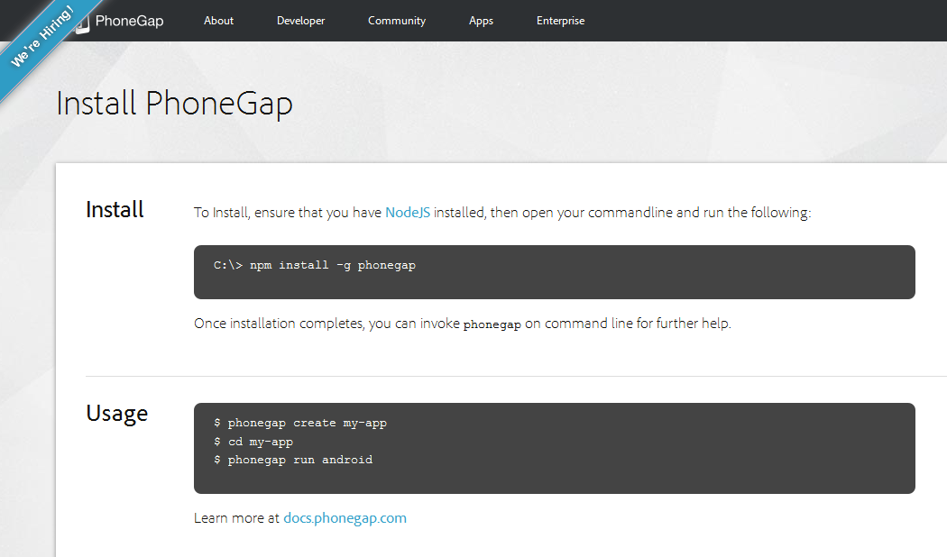
Installing PhoneGap
Command Line

Slide 8
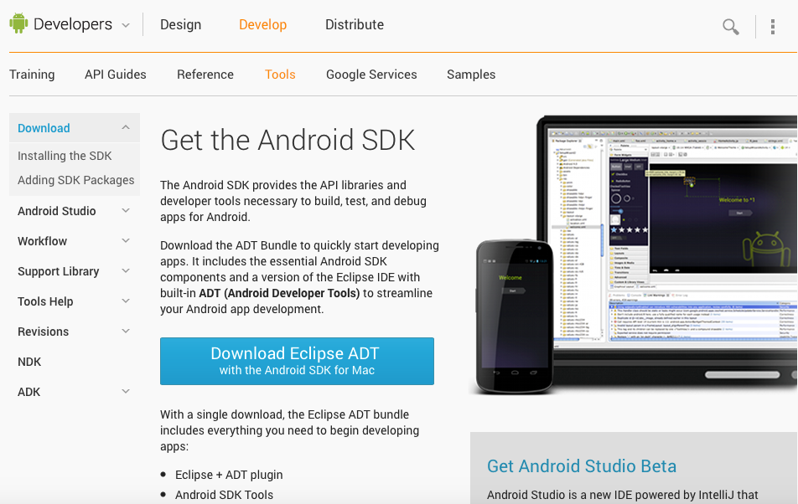
Installing Android
With a single download, you get
• Eclipse + ADT plugin
• Android SDK Tools
• Android Platform-tools
• A version of the Android platform
• A version of the Android system image for the emulator

Slide 9
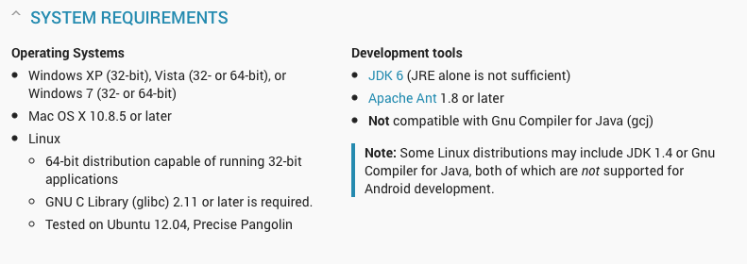
Android SDK System Requirements

